Slide 1

Data Description
Session 7
M. Kachour

Slide 2
Dispersion indicators
A numerical indicator is said to be dispersion if it is a key number used to measure the variability of observations in a statistical series.
A dispersion indicator is always positive (the higher its value, the more observations are "spread" around a central position indicator (the mean or median))

Slide 3
Dispersion indicators
We will study the following indicators:
Variance and standard deviation
The coefficient of variation
The range
The interquartile range
The relative interquartile coefficient
Indicators associated with data from a quantitative variable only

Slide 4
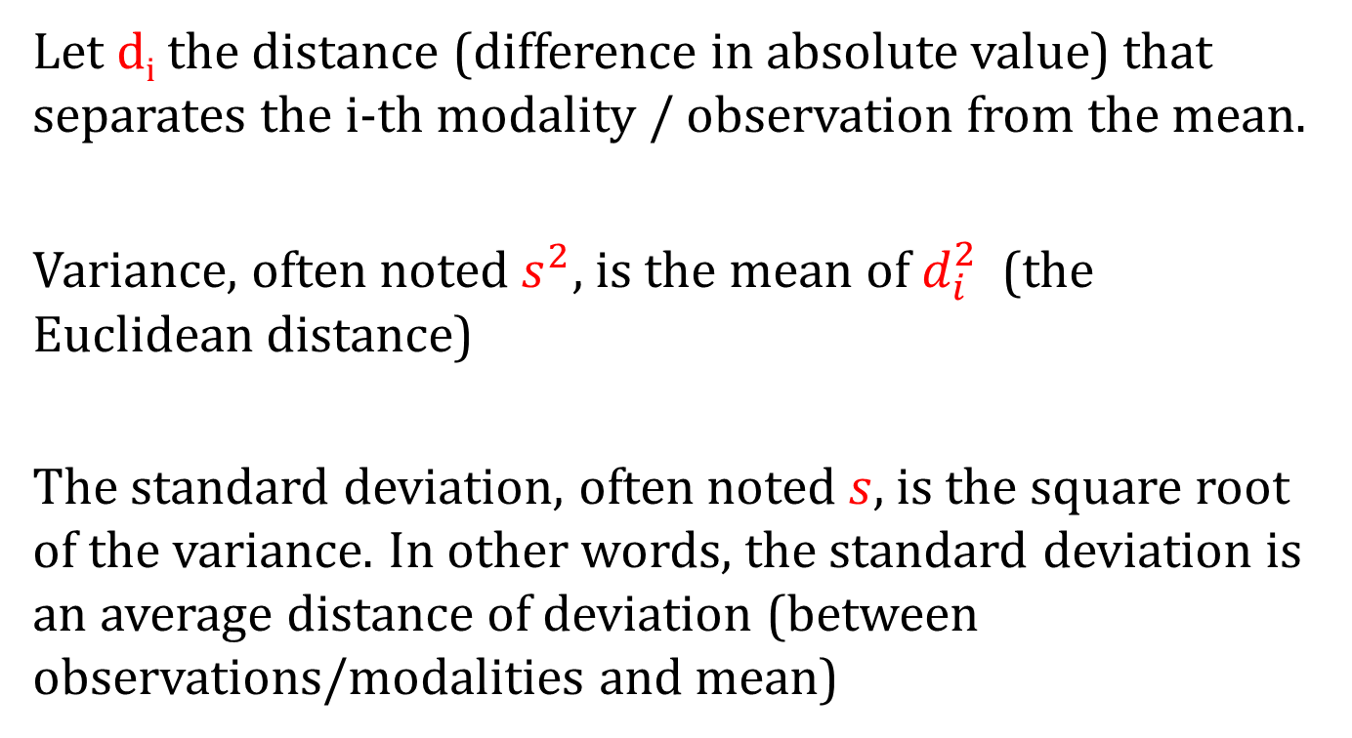
Dispersion Indicators –
Variance and Standard Deviation
Let d_{i} the distance (difference in absolute value) that separates the i-th modality / observation from the mean.
Variance, often noted $s^{2}$, is the mean of $d_{i}^{2}$ (the Euclidean distance)
The standard deviation, often noted $s$, is the square root of the variance. In other words, the standard deviation is an average distance of deviation (between observations/modalities and mean)

Slide 5
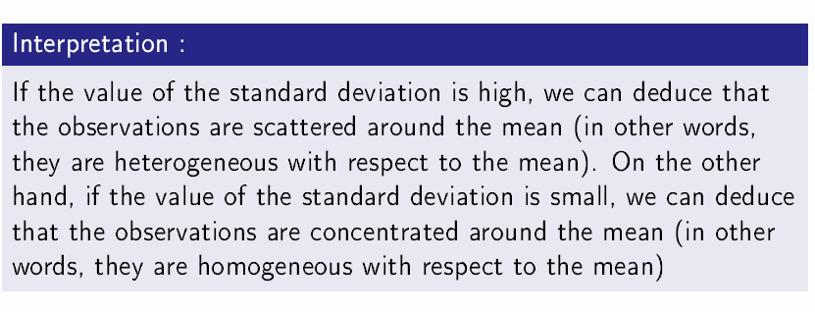
Dispersion Indicators –
Variance and Standard Deviation

Slide 6
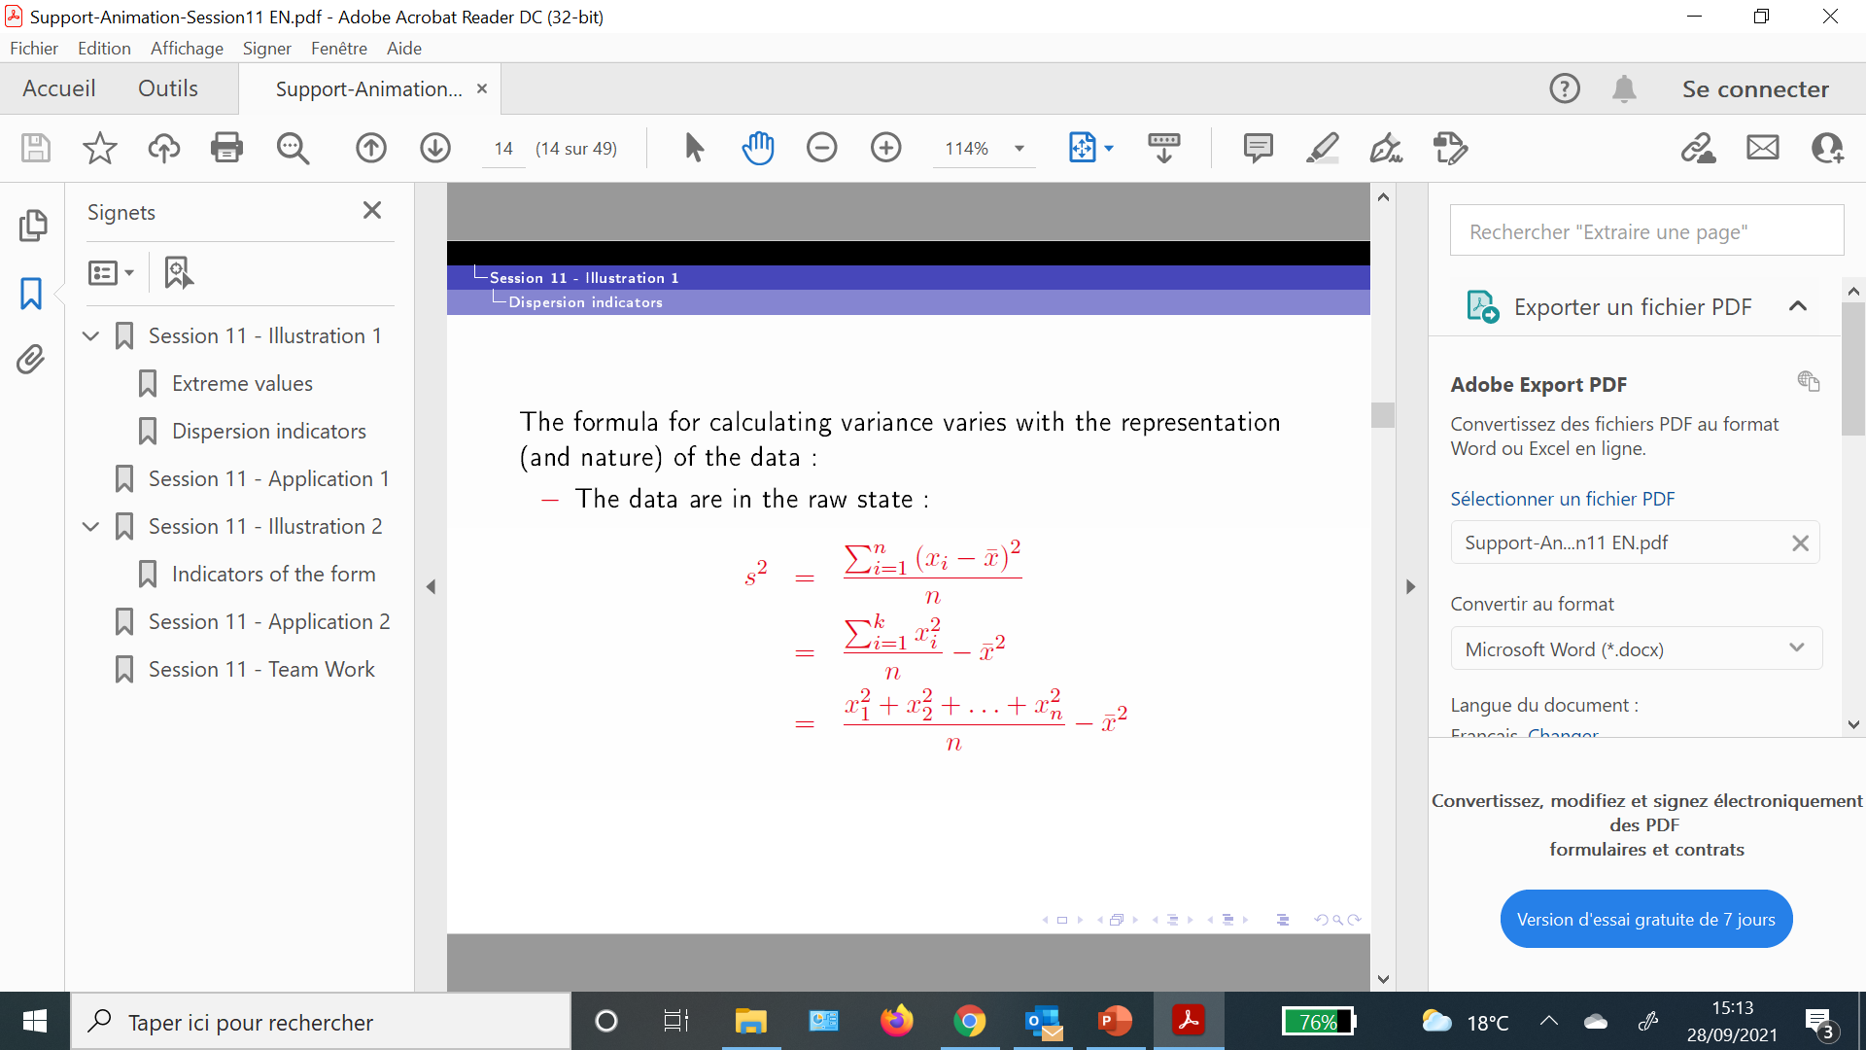
Dispersion Indicators –
Variance and Standard Deviation

Slide 7
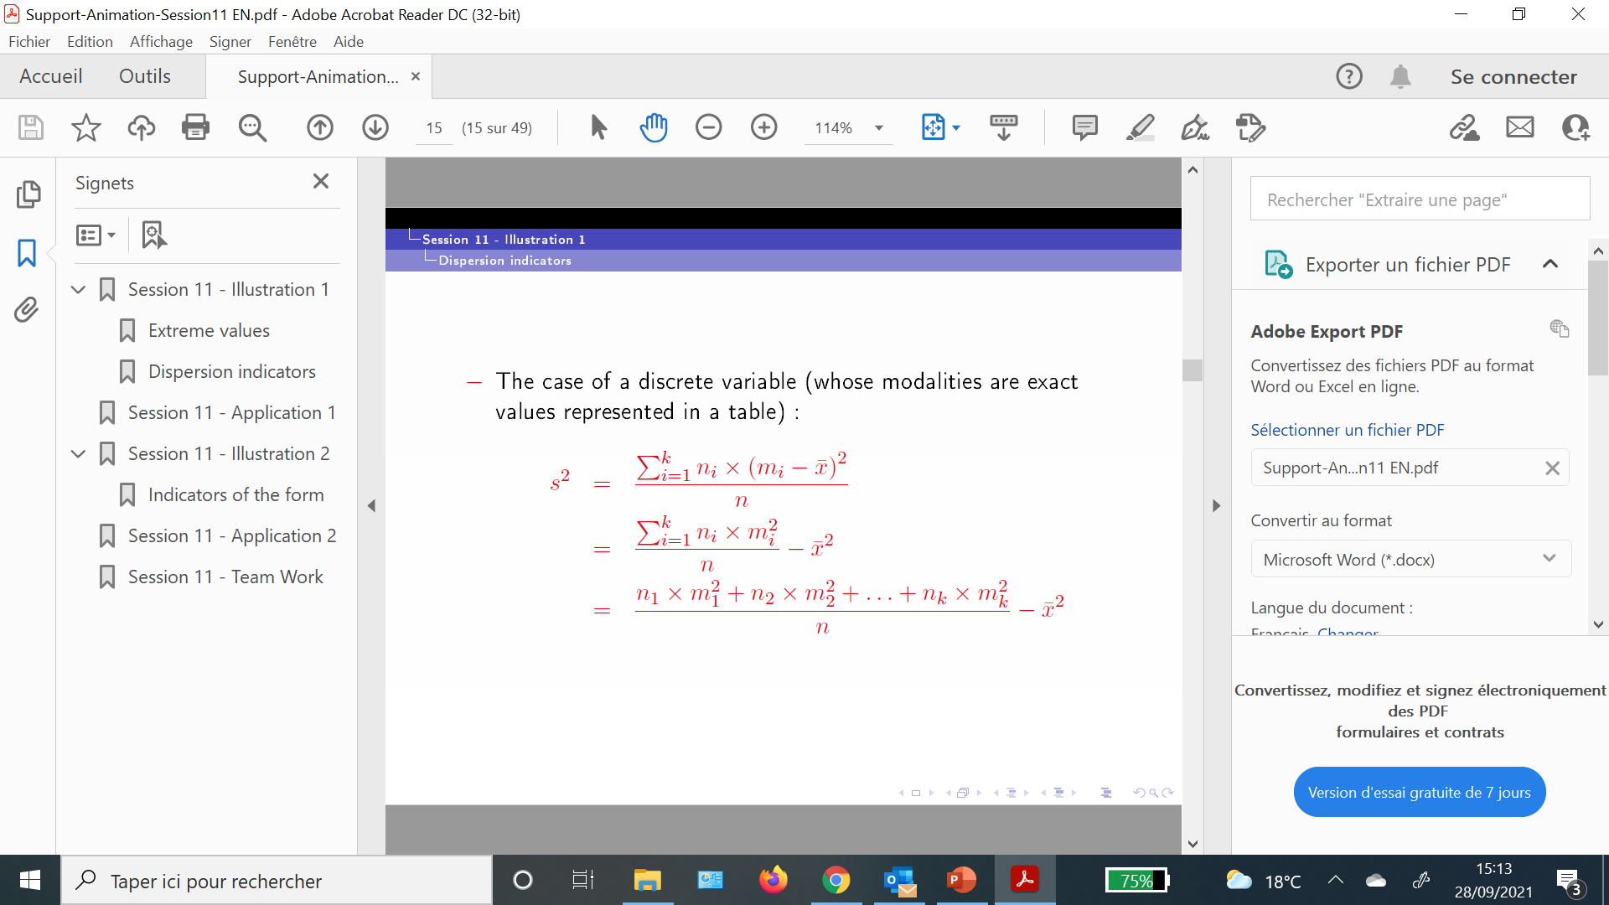
Dispersion Indicators –
Variance and Standard Deviation

Slide 8

Dispersion Indicators –
Variance and Standard Deviation

Slide 9
Examples – calculation of variance and standard deviation
Example 1 :
The data below represents the grades / scores of 10 students:
12, 10, 8, 8, 11, 11, 7, 14, 11, 12
Calculate the standard deviation.

Slide 10

Examples – calculation of variance and standard deviation
Example 1 :

Slide 11
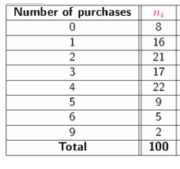
Examples – calculation of variance and standard deviation
Example 2 :
The data below represent the number of purchases (per week) of a product studied out of 100 French families
Calculate the standard deviation.

Slide 12
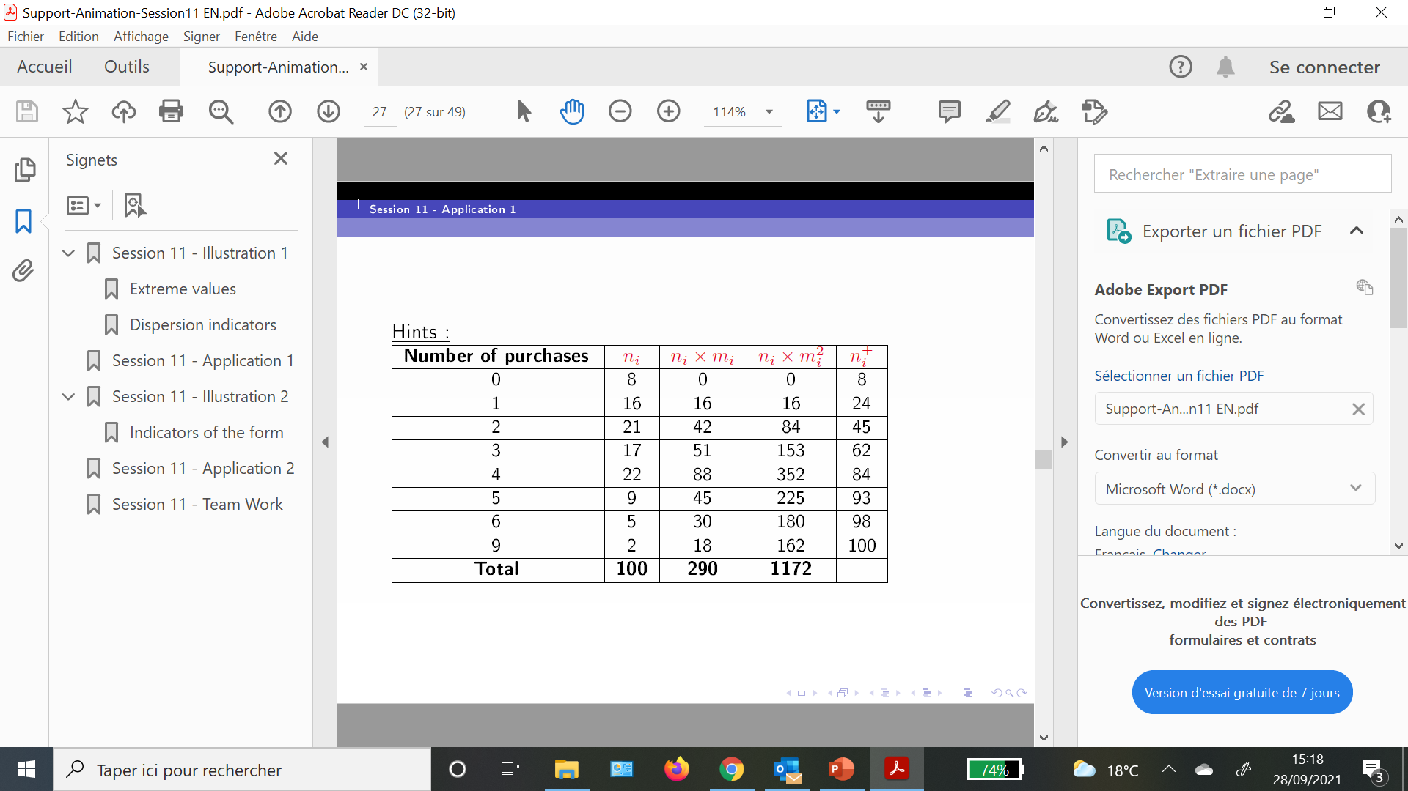

Examples – calculation of variance and standard deviation
Example 2 :

Slide 13
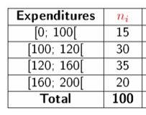
Examples – calculation of variance and standard deviation
Example 3 :
The data below represents the monthly expenses of 100 households for the purchase of a certain product
Calculate the standard deviation.n

Slide 14
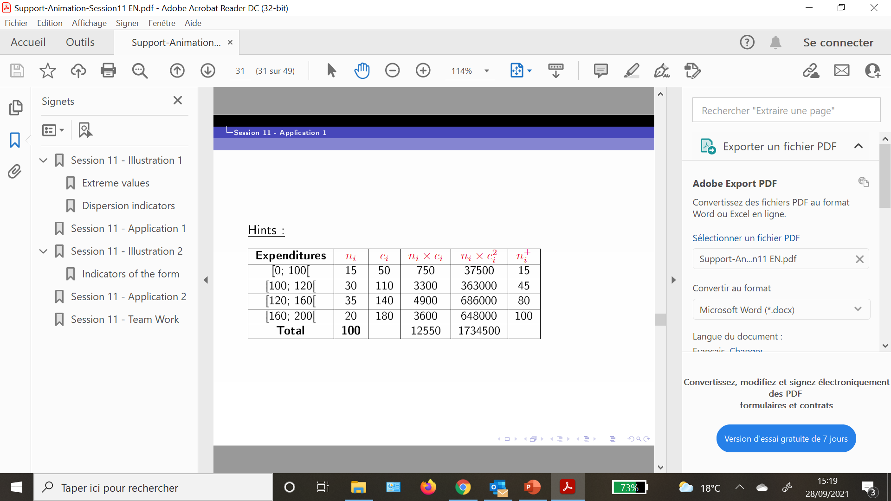
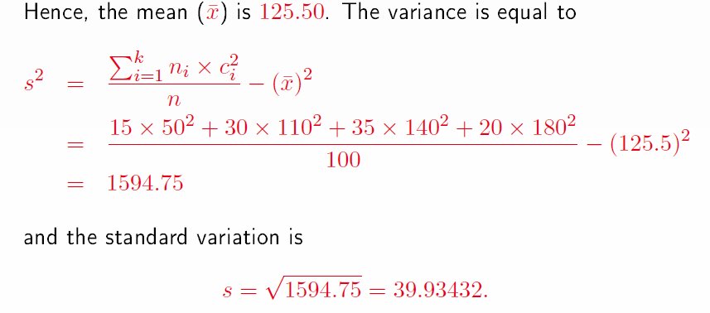
Examples – calculation of variance and standard deviation
Example 3 :

Slide 15
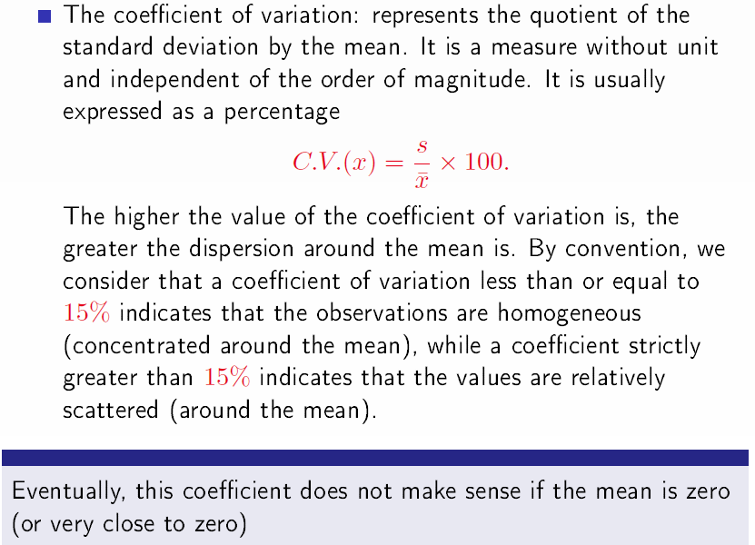
Dispersion Indicators –
The Coefficient of Variation

Slide 16
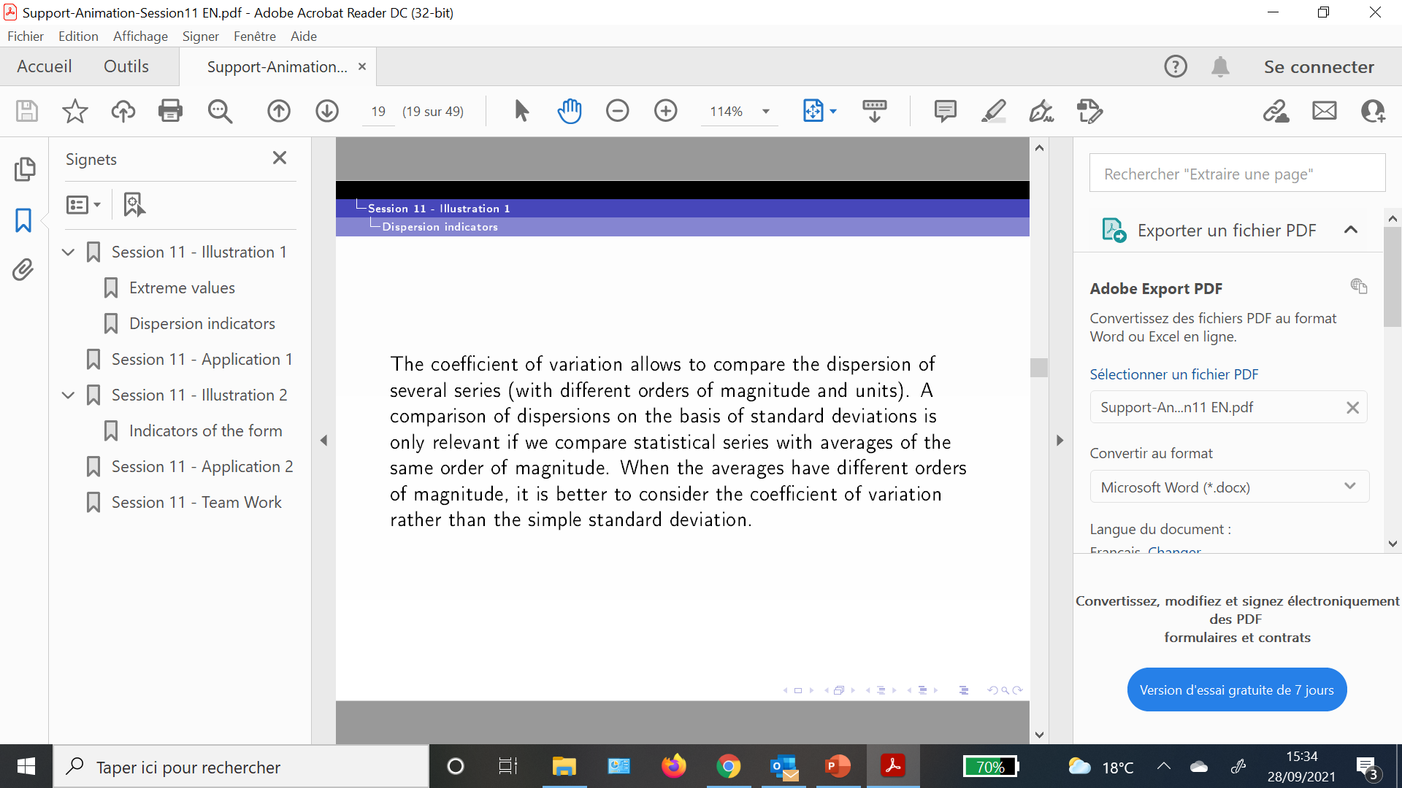
Dispersion Indicators – The Coefficient of Variation

Slide 17
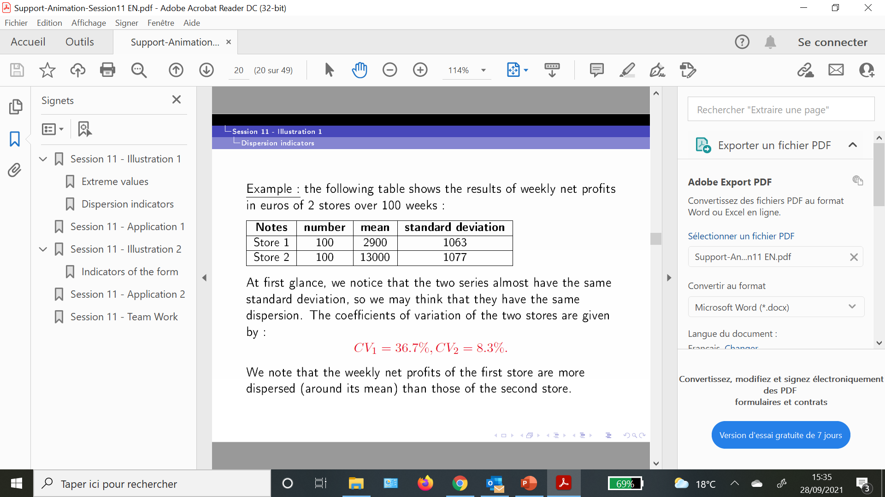
Dispersion Indicators – The Coefficient of Variation

Slide 18
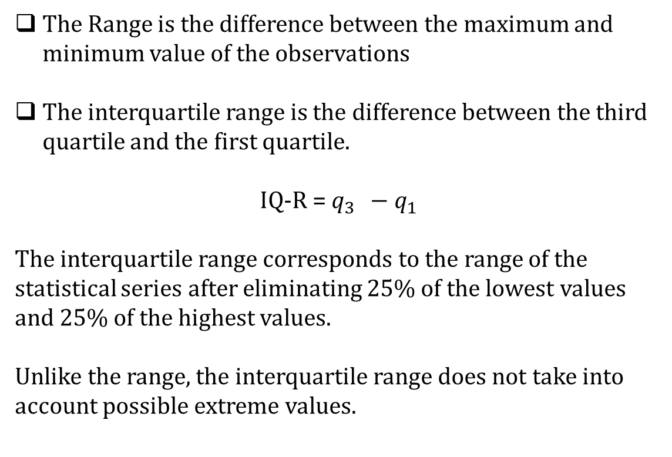
Dispersion Indicators –
The Range and The Interquartile Range
The Range is the difference between the maximum and minimum value of the observations
The interquartile range is the difference between the third quartile and the first quartile.
IQ-R = $q_{3 } −q_{1}$
The interquartile range corresponds to the range of the statistical series after eliminating 25% of the lowest values and 25% of the highest values.
Unlike the range, the interquartile range does not take into account possible extreme values.

Slide 19
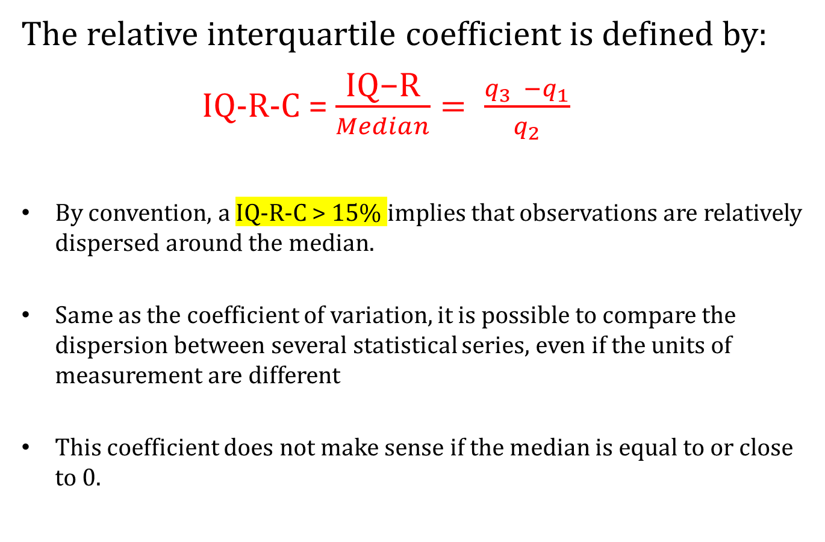
Dispersion Indicators –
The Relative Interquartile Coefficient
The relative interquartile coefficient is defined by:
IQ-R-C = $\frac{\text{IQ}\text{−}\text{R}}{Median}= \frac{q_{3 } −q_{1}}{q_{2}}$
By convention, a IQ-R-C > 15% implies that observations are relatively dispersed around the median.
Same as the coefficient of variation, it is possible to compare the dispersion between several statistical series, even if the units of measurement are different
This coefficient does not make sense if the median is equal to or close to 0.

Slide 20
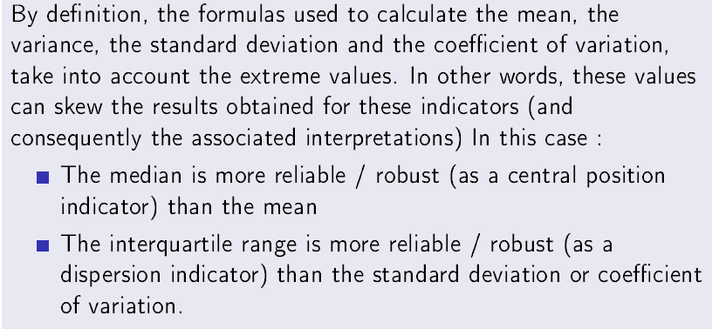
General remark

